Slide 1
PIN DIAGRAM OF 8085

Slide 2
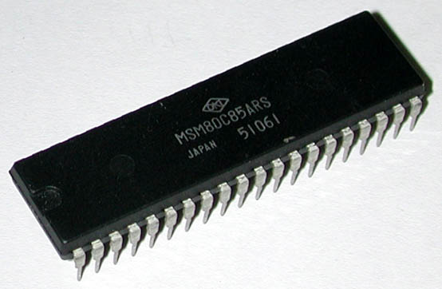
Introduction to 8085
It was introduced in 1977.
It is 8-bit microprocessor.
Its actual name is 8085 A.
It is single NMOS device.
It contains 6200 transistors approx.
Its dimensions are
164 mm x 222 mm.
It is having 40 pins Dual-Inline-Package (DIP).

Slide 3
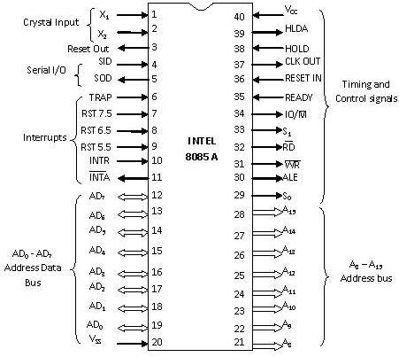
Pin Diagram of 8085

Slide 4
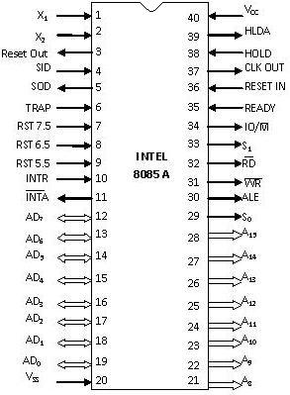
X₁ & X₂
Pin 1 and Pin 2 (Input)
These are also called Crystal Input Pins.
8085 can generate clock signals internally.
To generate clock signals internally, 8085 requires external inputs from X₁ and X₂.

Slide 5
RESET IN and RESET OUT
Pin 36 (Input) and Pin 3 (Output)
RESET IN:
  It is used to reset the microprocessor.
  It is active low signal.
  When the signal on this pin is low for at least 3 clocking cycles, it forces the microprocessor to reset itself.

Slide 6
RESET IN and RESET OUT
Pin 36 (Input) and Pin 3 (Output)
Resetting the microprocessor means:
  Clearing the PC(Program counter) and IR (Instruction registor).
  Disabling all interrupts (except TRAP).
  Disabling the SOD pin.
  All the buses (data, address, control) are tri-stated.
  Gives HIGH output to RESET OUT pin.

Slide 7
RESET IN and RESET OUT
Pin 36 (Input) and Pin 3 (Output)
RESET OUT:
  It is used to reset the peripheral devices and other ICs on the circuit.
  It is an output signal.
  It is an active high signal.
  The output on this pin goes high whenever RESET IN is given low signal.
  The output remains high as long as RESET IN is kept low.

Slide 8
SID and SOD
Pin 4 (Input) and Pin 5 (Output)
SID (Serial Input Data):
  It takes 1 bit input from serial port of 8085.
  Stores the bit at the 8th position (MSB) of the Accumulator.
  RIM (Read Interrupt Mask) instruction is used to transfer the bit.

Slide 9
SID and SOD
Pin 4 (Input) and Pin 5 (Output)
SOD (Serial Output Data):
  It takes 1 bit from Accumulator to serial port of 8085.
  Takes the bit from the 8th position (MSB) of the Accumulator.
  SIM (Set Interrupt Mask) instruction is used to transfer the bit.

Slide 10
Interrupt Pins
Interrupt:
  It means interrupting the normal execution of the microprocessor.
  When microprocessor receives interrupt signal, it discontinues whatever it was executing.
  It starts executing new program indicated by the interrupt signal.
  Interrupt signals are generated by external peripheral devices.
  After execution of the new program, microprocessor goes back to the previous program.

Slide 11
Five Hardware Interrupts in 8085
TRAP
RST 7.5
RST 6.5
RST 5.5
INTR

Slide 12
Classification of Interrupts
Maskable and Non-Maskable
Vectored and Non-Vectored
Edge Triggered and Level Triggered
Priority Based Interrupts

Slide 13
Maskable Interrupts
Maskable interrupts are those interrupts which can be enabled or disabled.
Enabling and Disabling is done by software instructions.

Slide 14
Maskable Interrupts
List of Maskable Interrupts:
  RST 7.5
  RST 6.5
  RST 5.5
  INTR

Slide 15
Non-Maskable Interrupts
The interrupts which are always in enabled mode are called non-maskable interrupts.
These interrupts can never be disabled by any software instruction.
TRAP is a non-maskable interrupt.

Slide 16
Vectored Interrupts
The interrupts which have fixed memory location for transfer of control from normal execution.
Each vectored interrupt points to the particular location in memory.

Slide 17
Vectored Interrupts
List of vectored interrupts:
  RST 7.5
  RST 6.5
  RST 5.5
  TRAP

Slide 18
Vectored Interrupts
The addresses to which program control goes:
Absolute address is calculated by multiplying the RST value with 0008 H.
Name | Vectored Address
RST 7.5 | 003C H (7.5 x 0008 H)
RST 6.5 | 0034 H (6.5 x 0008 H)
RST 5.5 | 002C H (5.5 x 0008 H)
TRAP | 0024 H (4.5 x 0008 H)

Slide 19
Non-Vectored Interrupts
The interrupts which don't have fixed memory location for transfer of control from normal execution.
The address of the memory location is sent along with the interrupt.
INTR is a non-vectored interrupt.

Slide 20
Edge Triggered Interrupts
The interrupts which are triggered at leading or trailing edge are called edge triggered interrupts.
RST 7.5 is an edge triggered interrupt.
It is triggered during the leading (positive) edge.

Slide 21
Level Triggered Interrupts
The interrupts which are triggered at high or low level are called level triggered interrupts.
RST 6.5
RST 5.5
INTR
TRAP is edge and level triggered interrupt.

Slide 22
Priority Based Interrupts
Whenever there exists a simultaneous request at two or more pins then the pin with higher priority is selected by the microprocessor.
Priority is considered only when there are simultaneous requests.

Slide 23
Priority Based Interrupts
Priority of interrupts:
Interrupt | Priority
TRAP | 1
RST 7.5 | 2
RST 6.5 | 3
RST 5.5 | 4
INTR | 5

Slide 24
TRAP
Pin 6 (Input)
It is an non-maskable interrupt.
It has the highest priority.
It cannot be disabled.
It is both edge and level triggered.
It means TRAP signal must go from low to high.
And must remain high for a certain period of time.
TRAP is usually used for power failure and emergency shutoff.

Slide 25
RST 7.5
Pin 7 (Input)
It is a maskable interrupt.
It has the second highest priority.
It is positive edge triggered only.
The internal flip-flop is triggered by the rising edge.
The flip-flop remains high until it is cleared by RESET IN.

Slide 26
RST 6.5
Pin 8 (Input)
It is a maskable interrupt.
It has the third highest priority.
It is level triggered only.
The pin has to be held high for a specific period of time.
RST 6.5 can be enabled by EI instruction.
It can be disabled by DI instruction.

Slide 27
RST 5.5
Pin 9 (Input)
It is a maskable interrupt.
It has the fourth highest priority.
It is also level triggered.
The pin has to be held high for a specific period of time.
This interrupt is very similar to RST 6.5.

Slide 28
INTR
Pin 10 (Input)
It is a maskable interrupt.
It has the lowest priority.
It is also level triggered.
It is a general purpose interrupt.
By general purpose we mean that it can be used to vector microprocessor to any specific subroutine having any address.

Slide 29
INTA
Pin 11 (Output)
It stands for interrupt acknowledge.
It is an out going signal.
It is an active low signal.
Low output on this pin indicates that microprocessor has acknowledged the INTR request.

Slide 30
Address and Data Pins
Address Bus:
  The address bus is used to send address to memory.
  It selects one of the many locations in memory.
  Its size is 16-bit.

Slide 31
Address and Data Pins
Data Bus:
  It is used to transfer data between microprocessor and memory.
  Data bus is of 8-bit.

Slide 32
AD₀ – AD₇
Pin 19-12 (Bidirectional)
These pins serve the dual purpose of transmitting lower order address and data byte.
During 1st clock cycle, these pins act as lower half of address.
In remaining clock cycles, these pins act as data bus.
The separation of lower order address and data is done by address latch.

Slide 33
A₈ – A₁₅
Pin 21-28 (Unidirectional)
These pins carry the higher order of address bus.
The address is sent from microprocessor to memory.
These 8 pins are switched to high impedance state during HOLD and RESET mode.

Slide 34
ALE
Pin 30 (Output)
It is used to enable Address Latch.
It indicates whether bus functions as address bus or data bus.
If ALE = 1 then
  Bus functions as address bus.
If ALE = 0 then
  Bus functions as data bus.

Slide 35
S₀ and S₁
Pin 29 (Output) and Pin 33 (Output)
S₀ and S₁ are called Status Pins.
They tell the current operation which is in progress in 8085.
S₀ | S₁ | Operation
0 | 0 | Halt
0 | 1 | Write
1 | 0 | Read
1 | 1 | Opcode Fetch

Slide 36
IO/M
Pin 34 (Output)
This pin tells whether I/O or memory operation is being performed.
If IO/M = 1 then
  I/O operation is being performed.
If IO/M = 0 then
  Memory operation is being performed.

Slide 37
IO/M
Pin 34 (Output)
The operation being performed is indicated by S₀ and S₁.
If S₀ = 0 and S₁ = 1 then
  It indicates WRITE operation.
If IO/M = 0 then
  It indicates Memory operation.
Combining these two we get Memory Write Operation.

Slide 38
Table Showing IO/M, S₀, S₁ and Corresponding Operations
Operations | IO/M | S₀ | S₁
Opcode Fetch | 0 | 1 | 1
Memory Read | 0 | 1 | 0
Memory Write | 0 | 0 | 1
I/O Read | 1 | 1 | 0
I/O Write | 1 | 0 | 1
Interrupt Ack. | 1 | 1 | 1
Halt | High Impedance | 0 | 0

Slide 39
RD
Pin 32 (Output)
RD stands for Read.
It is an active low signal.
It is a control signal used for Read operation either from memory or from Input device.
A low signal indicates that data on the data bus must be placed either from selected memory location or from input device.

Slide 40
WR
Pin 31 (Output)
WR stands for Write.
It is also active low signal.
It is a control signal used for Write operation either into memory or into output device.
A low signal indicates that data on the data bus must be written into selected memory location or into output device.

Slide 41
Controlling signal generating
IO/M bar | RD bar | WR bar
0 | 0 | 0 | Impossible condition
0 | 0 | 1 | MEMR bar
0 | 1 | 0 | MEMW bar
0 | 1 | 1 | No- operation
1 | 0 | 0 | Impossible condition
1 | 0 | 1 | IOR bar
1 | 1 | 0 | IOW bar
1 | 1 | 1 | No-operation
Maninder Kaur

Slide 42
READY
Pin 35 (Input)
This pin is used by microprocessor to detect whether a peripheral is ready for data transfer or not.
A low value causes the microprocessor to enter into wait state.
The microprocessor remains in wait state until the input at this pin goes high.

Slide 43
HOLD
Pin 38 (Input)
HOLD pin is used to request the microprocessor for DMA transfer.
A high signal on this pin is a request to microprocessor to hand over the hold on buses.
This request is sent by DMA controller.
Intel 8257 and Intel 8237 are two DMA controllers.

Slide 44
HLDA
Pin 39 (Output)
HLDA stands for Hold Acknowledge.
The microprocessor uses this pin to acknowledge the receipt of HOLD signal.
When HLDA signal goes high, address bus, data bus, RD, WR, IO/M pins are tri-stated.
This means they are cut-off from external environment.
Gursharan Singh Tatla
professorgstatla@gmail.com
www.eazynotes.com

Slide 45
HLDA
Pin 39 (Output)
The control of these buses goes to DMA Controller.
Control remains at DMA Controller until HOLD is held high.
When HOLD goes low, HLDA also goes low and the microprocessor takes control of the buses.

Slide 46
V_{SS} and V_{CC}
Pin 20 (Input) and Pin 40 (Input)
+5V power supply is connected to V_{CC}.
Ground signal is connected to V_{SS}.

